Slide 1
Arrays

Slide 2
Topics
Tables of Data
Arrays – Single Dimensional
Parsing a String into Multiple Tokens
Arrays - Multi-dimensional

Slide 3
Objectives
At the completion of this topic, students should be able to:
Write programs that correctly
* Declare and use single and multidimensional arrays
* Use loops to manipulate array elements
* Pass arrays to methods
Explain what an out of bounds error is and why it occurs
Declare and use single and 2-dimensional arrays in a program
Use the Split method to parse a string into multiple tokens

Slide 4
Motivation
Write a program that does the following:
Reads in 10 integer values from the user
Displays the sum of the values
Adds 5 to each value
Displays the new values and their sum

Slide 5
int number1 = 0;
int number2 = 0;
int number3 = 0;
int number4 = 0;
. . .
Console.WriteLine(“Enter in an integer value: )”;
number1 = int.Parse(Console.ReadLine( ) );
Console.WriteLine(“Enter in an integer value: )”;
number2 = int.Parse(Console.ReadLine( ) );
Console.WriteLine(“Enter in an integer value: )”;
number3 = int.Parse(Console.ReadLine( ) );
. . .

Slide 6
int sum = number1 + number2 + … + number10;
Console.WriteLine(“The sum = {0}“, sum);
number1 = numer1 + 5;
number2 = number2 + 5;
number 3 = number3 + 5;
. . .
Console.WriteLine(“Number1 = {0}“, number1);
Console.WriteLine(“Number1 = {0}“, number2);
Console.WriteLine(“Number1 = {0}“, number3);
. . .

Slide 7
What if I asked you to write a program like
this, but let the user enter 1000 values?
It could get pretty ugly!
Whenever a program deals with long lists of values
that are processed in a common way, think about
using an array to store your values in.

Slide 8
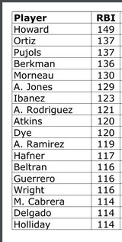
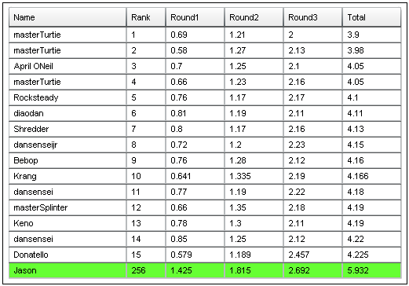
Examples of Tabular data
sports
Game programs

Slide 9
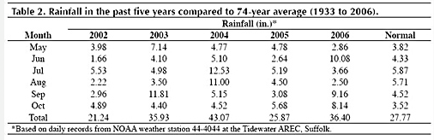
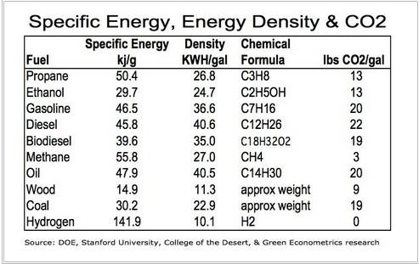
Weather data
Engineering data

Slide 10
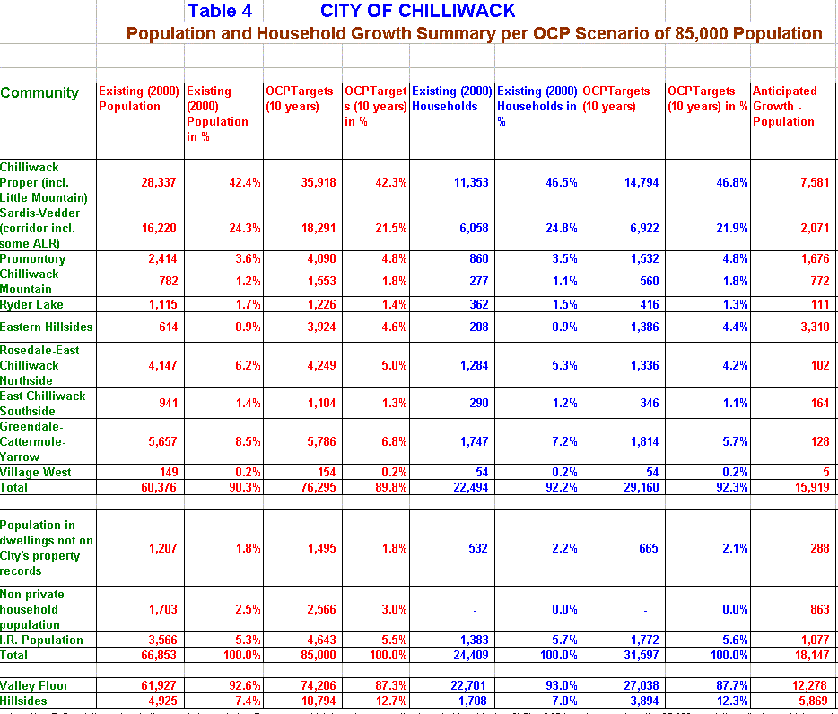
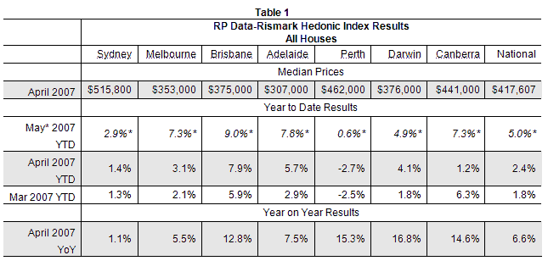
Population data
Sales and marketing data

Slide 11
An array is a list or table of values
An array has a single identifier for all its values
examScores
All values must be of the same type
89
0
Values are stored in consecutive
memory locations
1
94
78
2
The position where a value is stored
in an array is given by its index.
We sometimes refer to this as the
subscript.
93
3
75
4
99
5
82
6
Indexing always begins with zero
77
7
To access an element of an array, we
use the array name, followed by the index
inside of square brackets
int aResult = examScores[3];
53
8
87
9

Slide 12
index
examScores
array name
89
0
94
1
78
2
93
3
75
4
value of examScores[4]
99
5
The array index can also use an expression, such as
examScores[n+1];
6
82
77
7
53
8
87
9

Slide 13
index
examScores
base address
1200
89
0
1204
94
1
1208
78
2
examScores[4]
1212
93
3
1216
75
4
Array elements are stored in consecutive memory
locations. The compiler calculates the address
of a specific array element using the equation
address = base address + index * element size
99
5
82
6
77
7
53
8
1200 + 4 * 4
9
87

Slide 14
Declaring an Array
examScores
0
0
data type of array elements
array size
0
1
0
2
int[ ] examScores = new int[10];
0
3
0
4
0
5
0
6
Good programming style uses a constant for the
array size. For example
const int SIZE = 10;
int[ ] examScores = new int[SIZE];
0
7
0
8
0
9

Slide 15
Arrays are Objects
Array object on the Heap
0
0
0
1
examScores
0
2
0
3
reference
variable
0
4
0
5
0
6
0
7
0
8
0
9

Slide 16
Accessing Array Elements
examScores
examScores
12
0
12
0
examScores [ 0 ] = 12;
1
0
1
0
2
2
0
3
3
array name
0
4
4
index
(must be an integer value or
an expression that results in
an integer value )
5
0
5
6
0
6
7
0
7
Console.WriteLine(examScores[0] ) ;
8
0
8
9
0
9

Slide 17
Arrays and Loops
examScores
. . .
const int SIZE = 10;
const int MULTIPLE = 3;
int[ ] examScores = new int [ SIZE ];
for ( int i = 0; i < SIZE; i++ )
{
examScores[ i ] = i * MULTIPLE;
}
. . .
0
0
3
1
6
2
9
3
12
4
15
5
18
6
21
7
24
8
27
9

Slide 18
Arrays and Loops
examScores
. . .
const int SIZE = 10;
const int MULTIPLE = 3;
int[ ] examScores = new int [ SIZE ];
for ( int i = 0; i < SIZE; i++ )
{
examScores[ i ] = i * MULTIPLE;
}
. . .
0
0
3
1
6
2
9
3
12
4
15
5
Watch for off-by-one errors
The maximum index in an array
is one less than its size.
18
6
21
7
24
8
27
9

Slide 19
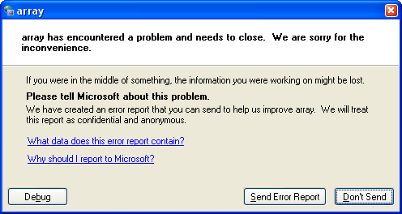
Out of Bounds Errors
When a C# program executes a statement that
accesses an array, it checks to make sure that the
element you are trying to access is actually
within the boundaries of the array (0 to SIZE-1).
If it is not, your program will terminate with an exception.

Slide 20
Initializer lists
int[ ] examScores = { 87, 83, 94, 99, 74, 66, 88 };
The array object is automatically created. The array size
is determined by the number of items in the initializer list.
The elements of the array are set to equal the values in the
initializer list.

Slide 21
Array Elements as Parameters
Array elements can be passed just as any other parameter…
for example
given the method
static void PrintInteger (int n);
we can pass a single element of an integer array as
PrintInteger (someData[n]);

Slide 22
Arrays as Parameters
the square brackets tell the compiler
that an array object will be passed.
void PrintEm( int[ ] r )
{
for( int i = 0; i < r.Length; i++ )
{
Console.WriteLine( r [ i ] );
}
}
static void Main( )
{
int[ ] mine = { 1, 2, 3, 4, 5 };
PrintEm ( mine );
}
}
The Array object has a
Length field that contains
the size of the array
Just pass the name of the
Array when invoking the method

Slide 23
Partially Filled Arrays
Often in a program, you don’t know how much data
will be stored in an array. So, you make the array
some very large maximum size, and then keep track
of how much data is in the array.

Slide 24
Developing a Program that Uses An Array

Slide 25
Arrays are used most often when writing an application that
deals with tabular data, for example …
Year
Average rainfall (in)
1941
1942
1943
1944
1945
1946
1947
1948
1949
1950
4.5
5.4
3.9
7.1
6.9
7.3
5.8
4.9
4.4
5.1

Slide 26
Suppose that we are given the average amounts of rainfall
for each of ten consecutive years, and we want to find
The average over the ten year period
The standard deviation of the rainfall data
Year
Average rainfall (in)
1941
1942
1943
1944
1945
1946
1947
1948
1949
1950
4.5
5.4
3.9
7.1
6.9
7.3
5.8
4.9
4.4
5.1

Slide 27
Since we are going to process each of these data elements
in turn as we do the calculations, an array is a handy way
of storing the data.
Year
Average rainfall (in)
1941
1942
1943
1944
1945
1946
1947
1948
1949
1950
4.5
5.4
3.9
7.1
6.9
7.3
5.8
4.9
4.4
5.1

Slide 28
Declare the array
double[ ] rainFall = new double[10];
rainFall
0
0
0
0
0
0
0
0
0
0

Slide 29
Read the data into the array
(assume that the user enters data from the keyboard)
rainFall
4.5
5.4
3.9
7.1
6.9
7.3
5.8
4.9
4.4
5.1
const int SIZE= 10;
for (int i = 0; i < SIZE; i++)
{
Console.WriteLine(“Enter the amount of rainfall”);
Console.Write(“for year {0}: “, i + 1);
rainfall[i] = double.Parse(Console.ReadLine( ) );
}

Slide 30
Calculate the average
rainFall
4.5
5.4
3.9
7.1
6.9
7.3
5.8
4.9
4.4
5.1
double sum = 0;
for (int i = 0; i < SIZE; i++)
{
sum += rainfall[ i ];
}
double average = sum / SIZE;

Slide 31
Calculate the standard deviation
Standard deviation is a measure of how
closely the data points are clustered
around the mean. The standard deviation
is found by
Finding how much each data point differs
from the average.
(2) Squaring this difference.
(2) Summing up the squares of the differences
(3) Dividing by the number of data points - 1
(4) And taking the square root of the result.
4.5
5.4
3.9
7.1
6.9
7.3
5.8
4.9
4.4
5.1

Slide 32
n
Σ
2
(x – x[i])
i = 0
n-1

Slide 33
Calculate the standard deviation
rainFall
4.5
5.4
3.9
7.1
6.9
7.3
5.8
4.9
4.4
5.1
double sumDeviation = 0;
double variation = 0;
for (int i = 0; i < SIZE; i++)
{
variation = (average – rainfall[ i ]);
sumDeviation += variation * variation;
}
double stdDeviation = Math.Sqrt(sumDeviation / (SIZE - 1 ) );

Slide 34
The foreach Loop
Processing each element of an array is such a common
operation, that C# provides a special loop construct to
do this. The foreach loop allows you to access each element
of an array in turn.
* You must process the entire array
* You cannot modify data in the array

Slide 35
The foreach Loop
int[ ] myScores = {56, 78, 81, 93, 21};
. . .
foreach (int score in myScores)
{
Console.WriteLine( score );
}

Slide 36
Practice
Write a program that does the following:
Creates an array of 10 integer values
Fills the array with random numbers between 0 and 50
Displays the contents of the array
Displays the values that are at an odd index
Displays the values in the array that are odd
Displays the values in the array in reverse order
Uses a method to add the numbers in the array
Uses a method to compute the average of the values in the array

Slide 37
Copying Arrays
Suppose that two arrays were declared as shown:
int[ ] odds = {1,3,5,9};
int[ ] evens = {2,4,6,8};
And you wrote …
odds = evens;
What do you expect would happen?

Slide 38
odds
1
3
5
9
odds = evens;
evens
2
4
6
8

Slide 39
odds
1
3
5
9
odds = evens;
This does what is called
a “Shallow Copy”. That is,
only the reference is copied.
the array data is not copied.
evens
2
4
6
8

Slide 40
odds
1
3
5
9
If you want to copy the array
data, you must use a loop:
for (int i = 0; i < 4; i++)
{
odds[i] = evens[i];
}
2
4
6
8
evens
2
4
6
8

Slide 41
Two Dimensional Arrays
columns
rows
How we think of a two dimensional array

Slide 42
examScores
student 1
78
89
65
97
student 2
76
79
82
85
student 3
83
89
91
90
exam 1
exam 2
exam 3
exam 4

Slide 43
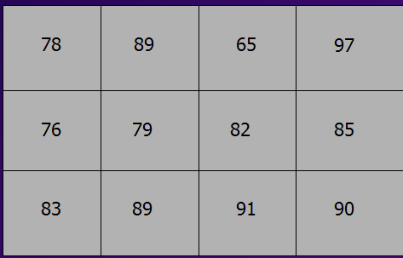
using System;
class Program
{
const int STUDENT = 3;
const int EXAMS = 4;
static void Main()
{
// declare an array 3 x 4
int[,] examScores = { {78, 89, 65, 97},{76, 79, 82, 85},{83, 89, 91, 90} };
for ( int i = 0; i < STUDENT; i++ )
{
int sum = 0;
for ( int j = 0; j < EXAMS; j++ )
sum = sum + examScores [ i , j ];
double avg = ((double)sum)/EXAMS;
Console.WriteLine("Student # {0}: {1}",i+1, avg);
}
}//End Main()
}//End class Program

Slide 44
Columns 0 1 2 3
Rows
0
1
2
using System;
class Program
{
const int STUDENT = 3;
const int EXAMS = 4;
static void Main()
{
// declare an array 3 x 4
int[,] examScores = { {78, 89, 65, 97}, {76, 79, 82, 85}, {83, 89, 91, 90} };
Notice how we indicate that
the array has two dimensions
each set of numbers is
one row of the table (0,1,2)

Slide 45
Columns 0 1 2 3
Rows
0
1
2
The first index is the row
for ( int i = 0; i < STUDENT; i++ )
{
int sum = 0;
for ( int j = 0; j < EXAMS; j++ )
sum = sum + examScores [ i , j ];
double avg = ((double)sum)/EXAMS;
Console.WriteLine("Student # {0}: {1}",i+1, avg);
}
The second index is the column
(This is termed “Row” major order)

Slide 46
Practice
Write a program that does the following:
Creates an array that holds the judges scores for 5 gymnasts
There are 3 judges
Gather the judges input
Compute the average score for each gymnast
Display the winning score

Slide 47
Parsing a String into multiple tokens
Suppose that you had the string
“Joe Mary Sam Bill Jane”
How would you get the individual
names out of this single string?

Slide 48
using System;
class Program
{
const int STUDENT = 3;
const int EXAMS = 4;
static void Main()
{
string names = "Joe Mary Sam Bill Jane";
string[ ] sepNames = names.Split( );
foreach(string name in sepNames)
Console.WriteLine(name);
}//End Main()
}//End class Program

Slide 49
Names are separated by white space
using System;
class Program
{
const int STUDENT = 3;
const int EXAMS = 4;
static void Main()
{
string names = "Joe Mary Sam Bill Jane";
string[ ] sepNames = names.Split( );
foreach(string name in sepNames)
Console.WriteLine(name);
}//End Main()
}//End class Program
names
Joe Mary Sam Bill Jane
sepNames
Joe
Mary
Sam
Bill
Jane

Slide 50
Reading until the user hits Enter
Get some data and save it in an array.
Quit when the user just hits Enter

Slide 51
string input;
. . .
input = Console.Readline( );
When the user just hits Enter,
no data is stored in the string.
You can test this by writing
if (input == “”) . . .

Slide 52
Practice
Write a program that does the following:
Declares an array of 10 strings and an array of ten integers
Get’s a student name and exam score from the user
Stores the name and score in their respective arrays
Stops when the user just hits the Enter key
Uses a method to compute the average score
Prints each student name, their score, and if their score is
- above average
- below average
- equal to the average

